Slide 1

Wholesale & Specialty Insurance Symposium: Risky Business
Hosted by Arizona State University
Phoenix, Arizona
October 10-11, 2019

Slide 2
Actuaries in Action Python in specialty products insurance
Zachary Luety ACAS, MAAA
Wholesale & Specialty Insurance Symposium: Risky Business
Arizona State University
Phoenix, Arizona | October 10-11, 2019

Slide 3



What’s in our toolbox?
Excel
Tableau/Power BI
SQL

Slide 4
What about soft skills?
Communication
Attention to Detail
Organization

Slide 5

Why learn programming?
You after programming
You before programming
Programming

Slide 6
Why learn programming?
Automate reporting
Minimize errors
Delegation

Slide 7
Why learn programming?
Access data from web
Use open-source tools to dive into novel approaches
Machine learning techniques
Natural Language processing

Slide 8
Why learn programming?
Its fun!

Slide 9
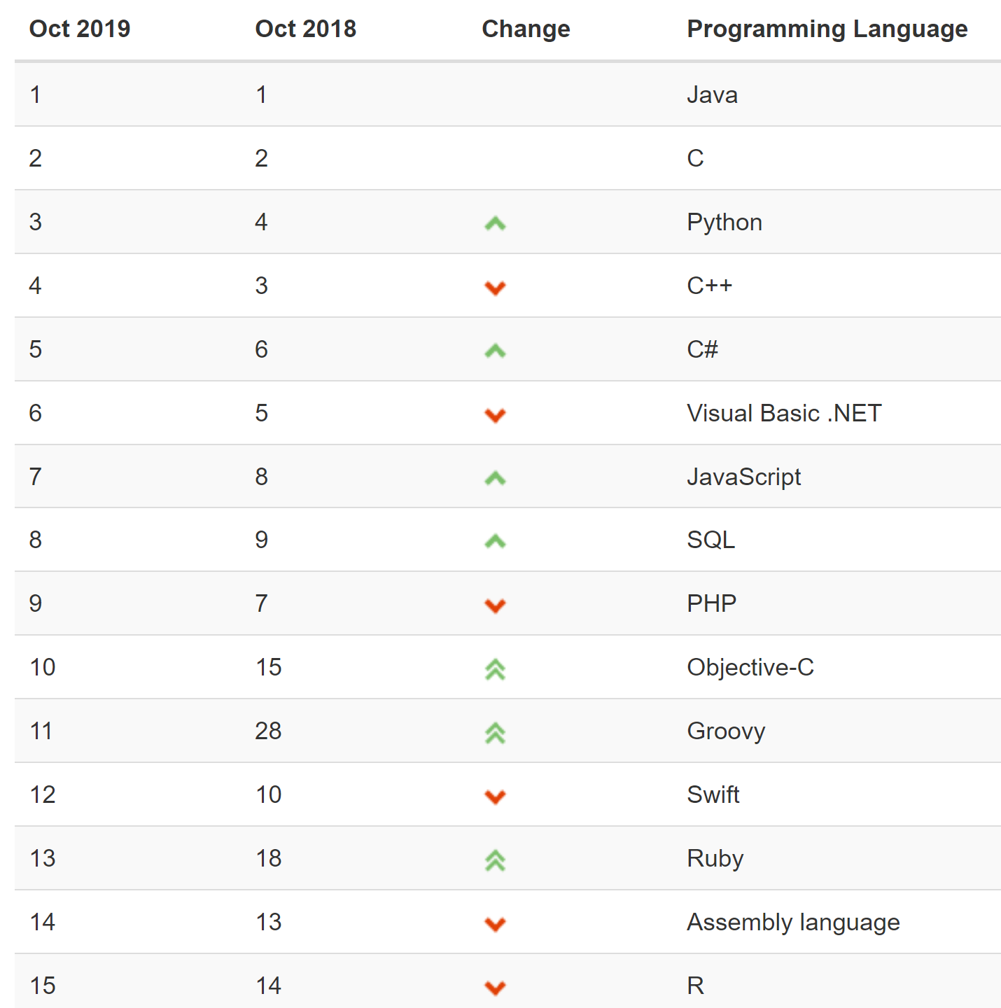
Choosing a language
Source: TIOBOE Index for October 2019
https://www.tiobe.com/tiobe-index/

Slide 10
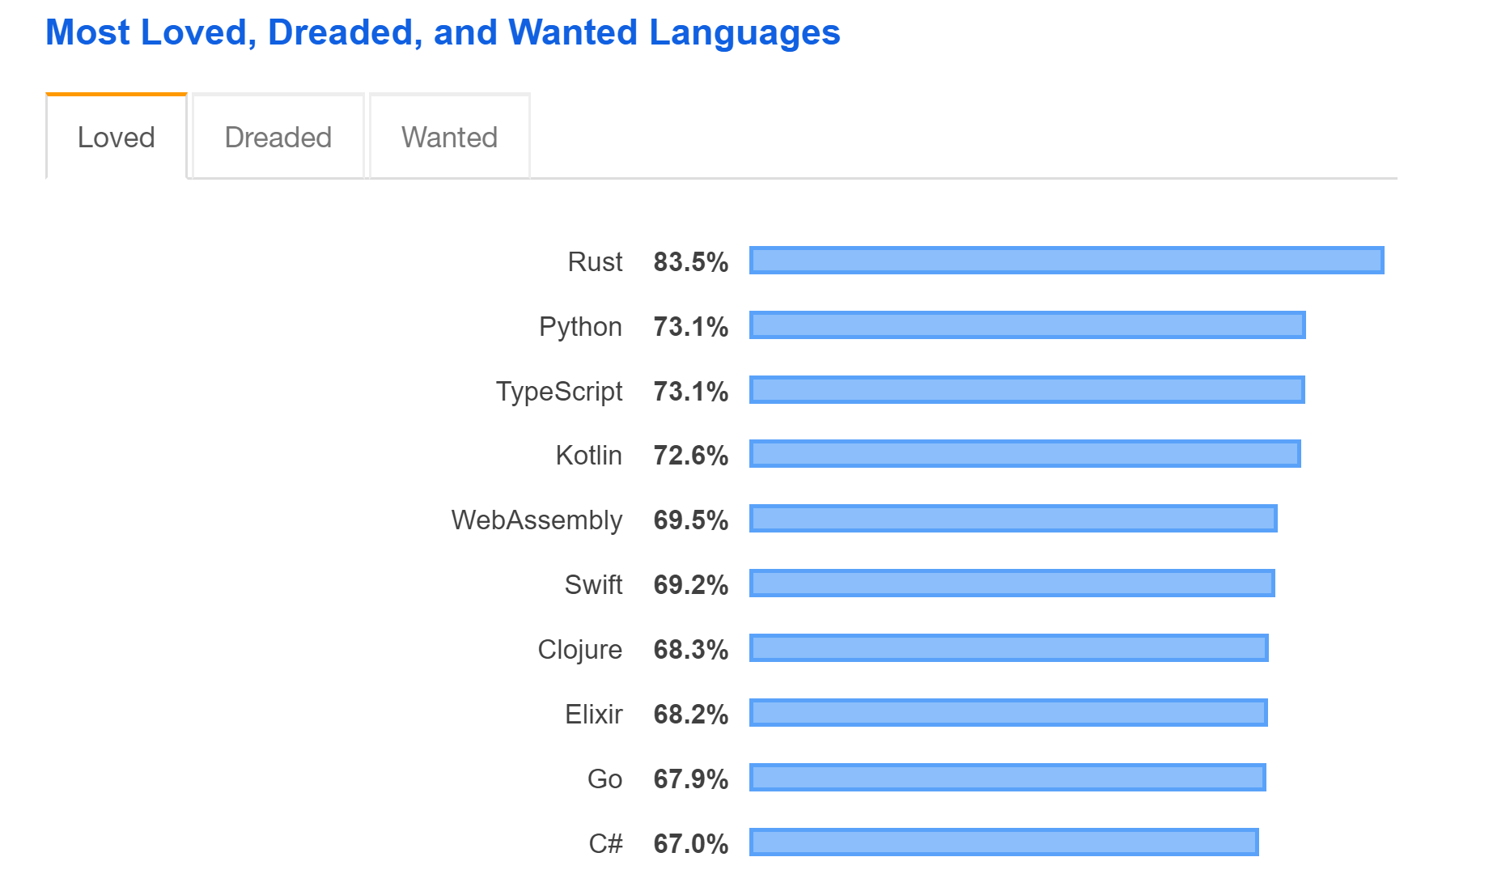
Source: Stack Overflow 2019 Developer Survey
https://insights.stackoverflow.com/survey/2019#technology

Slide 11
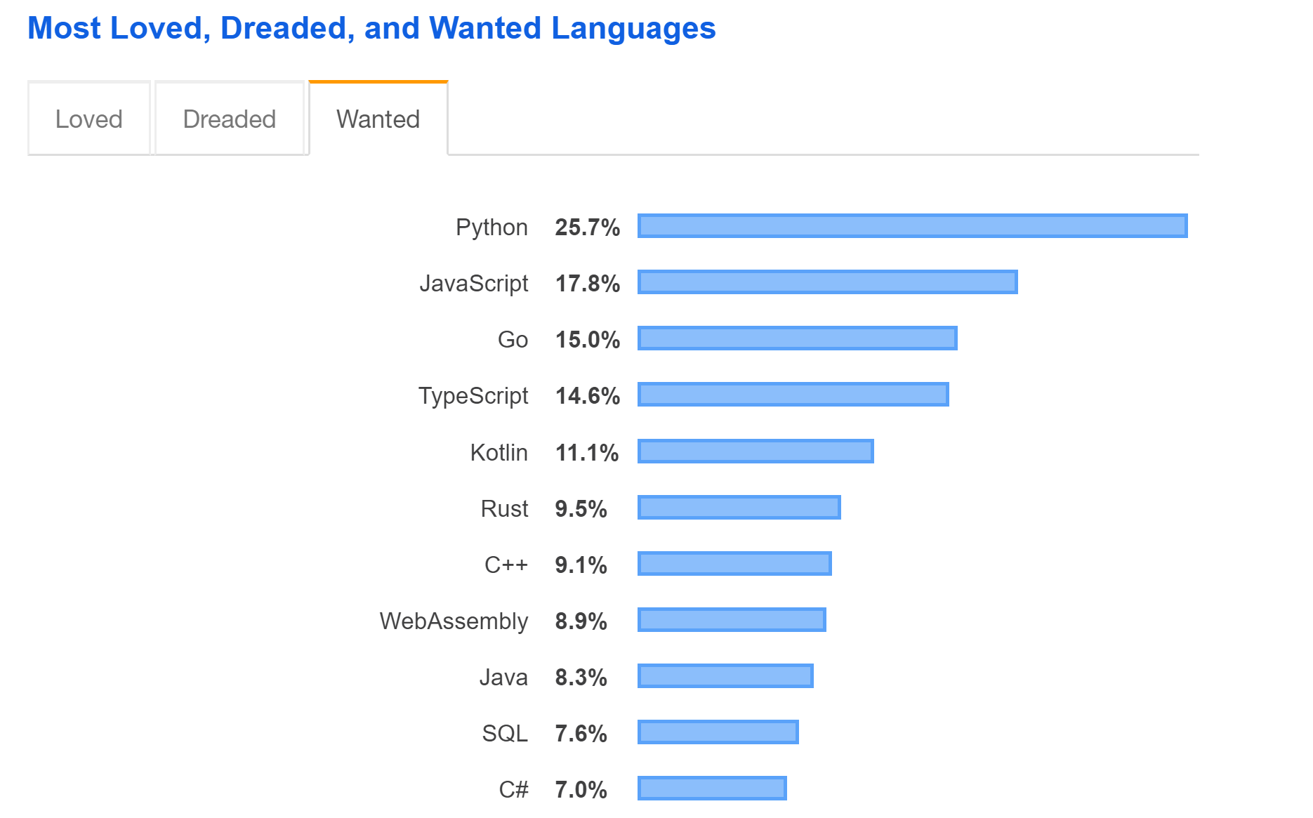
Source: Stack Overflow 2019 Developer Survey
https://insights.stackoverflow.com/survey/2019#technology

Slide 12

Intro to Python
https://github.com/gpwa-com/WSIA2019

Slide 13
Google Colab Shortcuts
Command | Keyboard Shortcut
Run cell and select next cell | Shift + Enter
Insert code cell above | Ctrl + M A
Insert code cell below | Ctrl + M B
Comment current line | Ctrl + /
Delete cell | Ctrl + M D
Convert to code cell | Ctrl + M Y
Convert to text cell | Ctrl + M M
Show keyboard shortcuts | Ctrl + M H

Slide 14

Intro to NumPy

Slide 15
Google Colab Shortcuts
Command | Keyboard Shortcut
Run cell and select next cell | Shift + Enter
Insert code cell above | Ctrl + M A
Insert code cell below | Ctrl + M B
Comment current line | Ctrl + /
Delete cell | Ctrl + M D
Convert to code cell | Ctrl + M Y
Convert to text cell | Ctrl + M M
Show keyboard shortcuts | Ctrl + M H

Slide 16
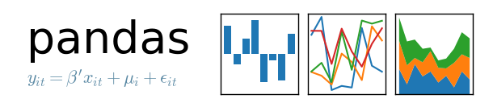
Intro to Pandas

Slide 17
Google Colab Shortcuts
Command | Keyboard Shortcut
Run cell and select next cell | Shift + Enter
Insert code cell above | Ctrl + M A
Insert code cell below | Ctrl + M B
Comment current line | Ctrl + /
Delete cell | Ctrl + M D
Convert to code cell | Ctrl + M Y
Convert to text cell | Ctrl + M M
Show keyboard shortcuts | Ctrl + M H

Slide 18
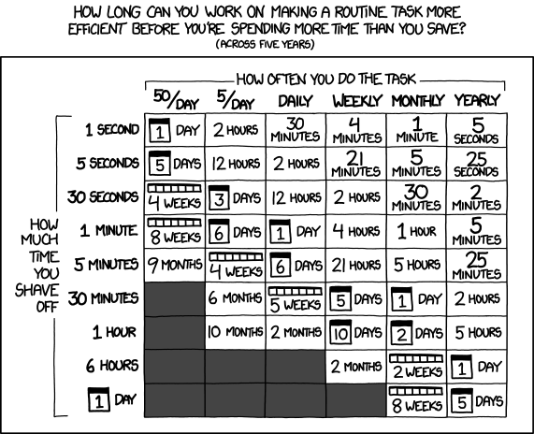
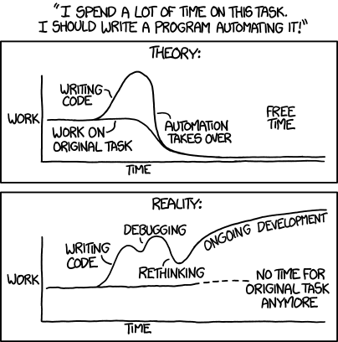
Cautions

Slide 19
Further Reading
Python
https://docs.python.org/3/
https://jakevdp.github.io/PythonDataScienceHandbook/
General
Practical Application of R to Actuarial Work
https://www.casact.org/community/affiliates/camar/1016/Sahasrabuddhe.pdf
Beyond Interactive: Notebook Innovation at Netflix
https://medium.com/netflix-techblog/notebook-innovation-591ee3221233

Slide 20
Questions
Contact:
Zach Luety
zluety@gpwa.com
Slides available at https://github.com/gpwa-com/WSIA2019

Slide 21
Internship Opportunity
Email resumes to gpwa@gpwa.com

